Slide 1
Landsat Metadata
www.kb.gg/databases
Kevin Booth

Slide 2
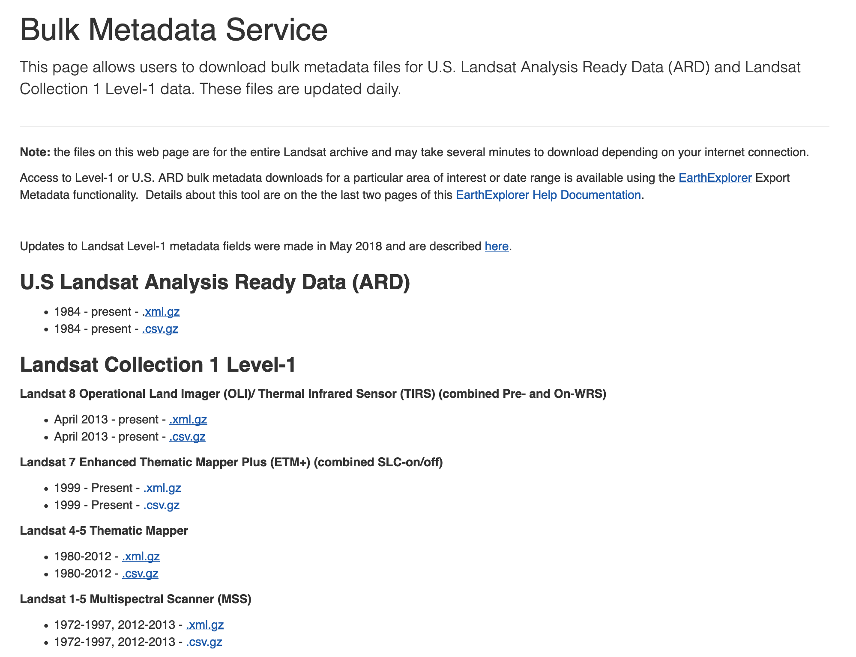
www.kb.gg/databases

Slide 3
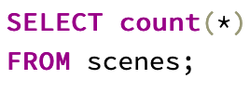
www.kb.gg/databases

Slide 4
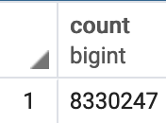
www.kb.gg/databases

Slide 5
www.kb.gg/databases
!

Slide 6
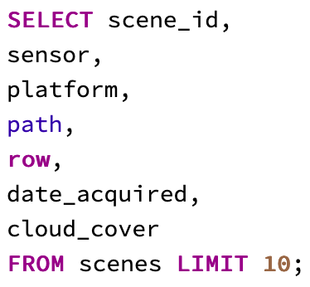
www.kb.gg/databases

Slide 7
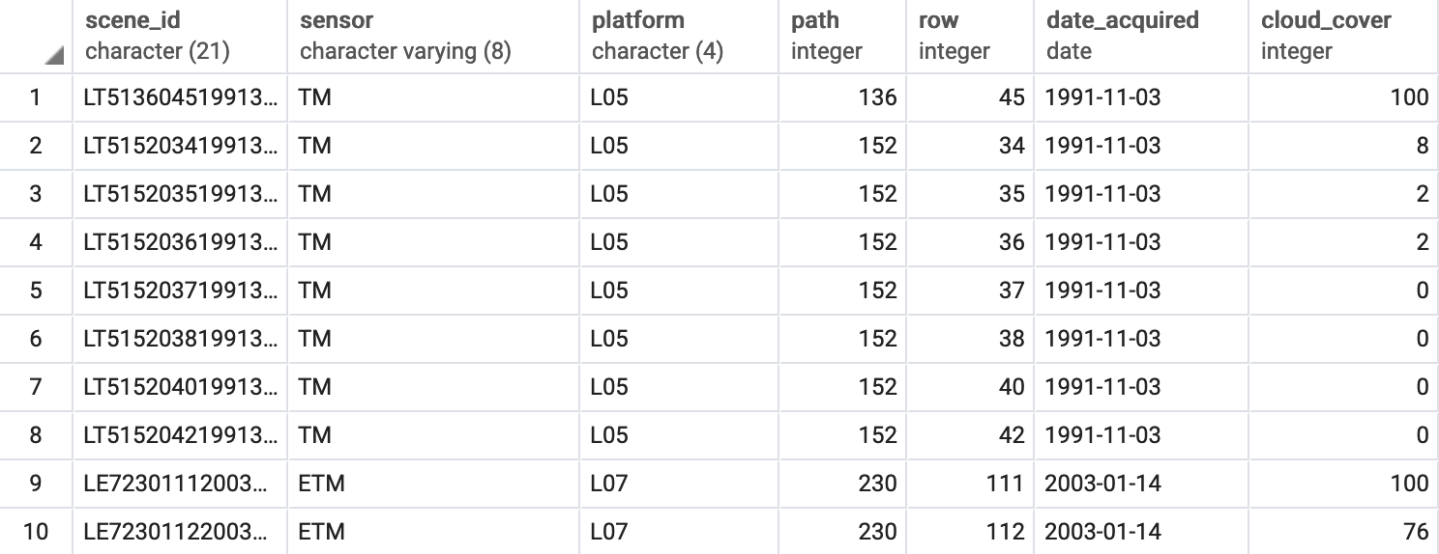
www.kb.gg/databases

Slide 8
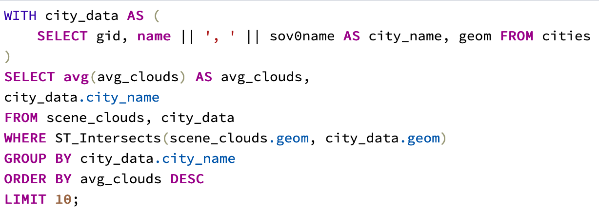
www.kb.gg/databases

Slide 9
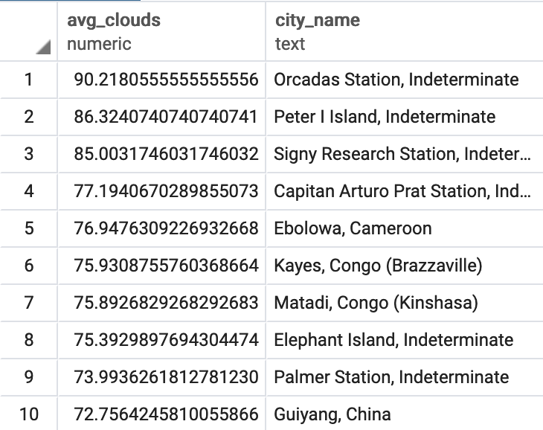
www.kb.gg/databases

Slide 10
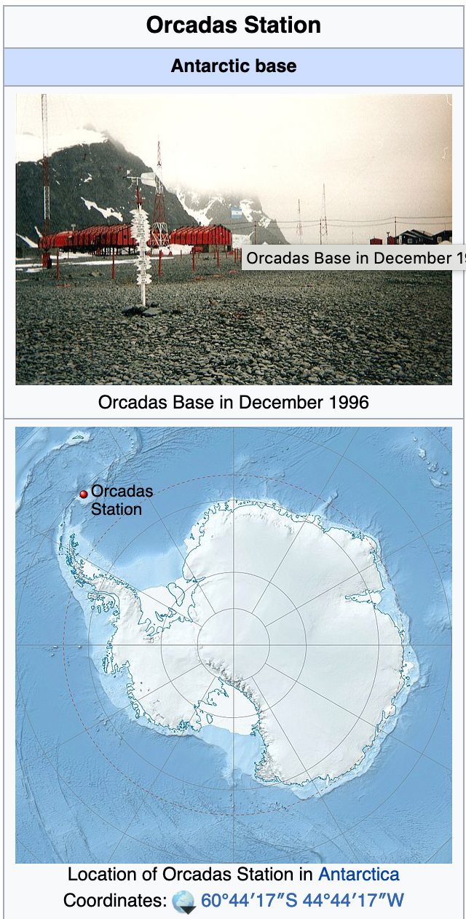
www.kb.gg/databases

Slide 11
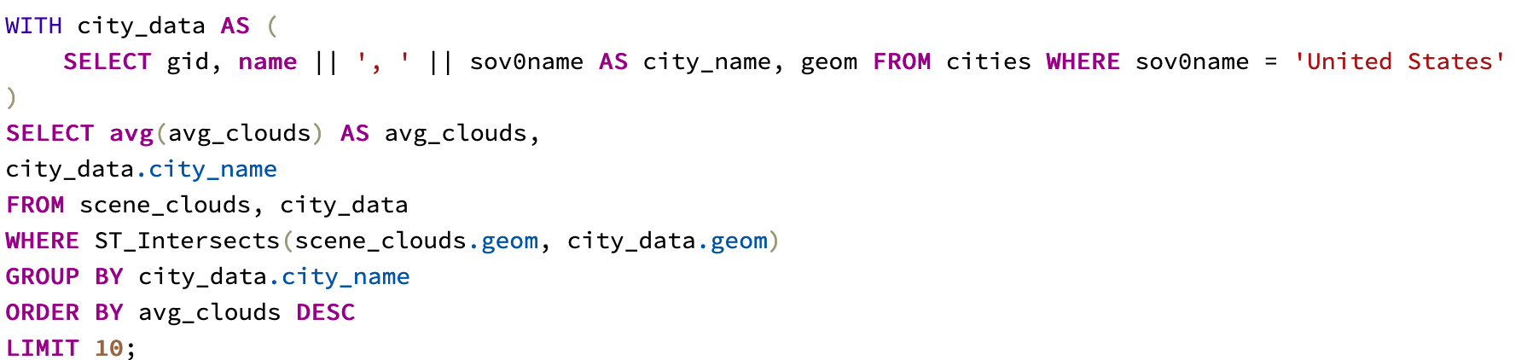
www.kb.gg/databases

Slide 12
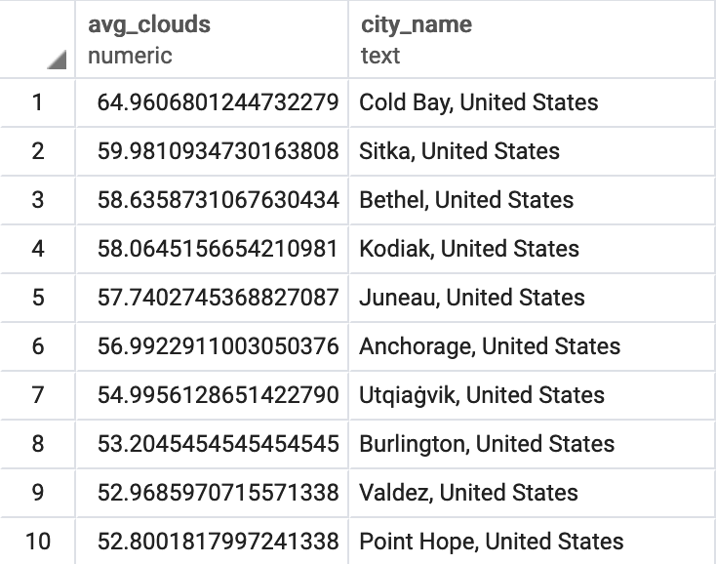
www.kb.gg/databases

Slide 13
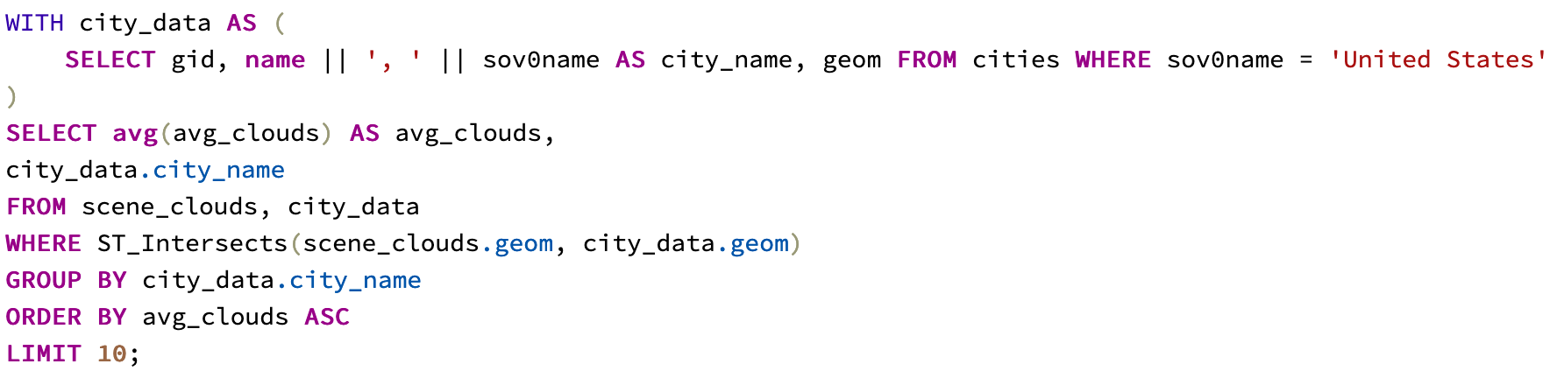
www.kb.gg/databases

Slide 14
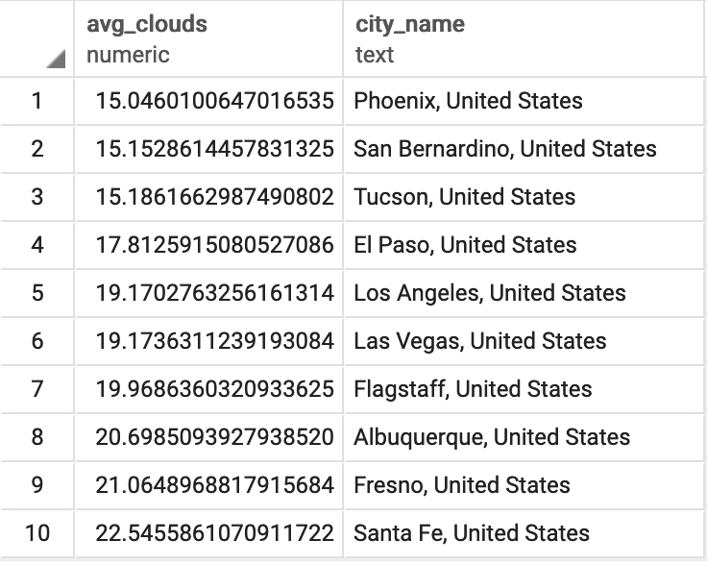
www.kb.gg/databases

Slide 15
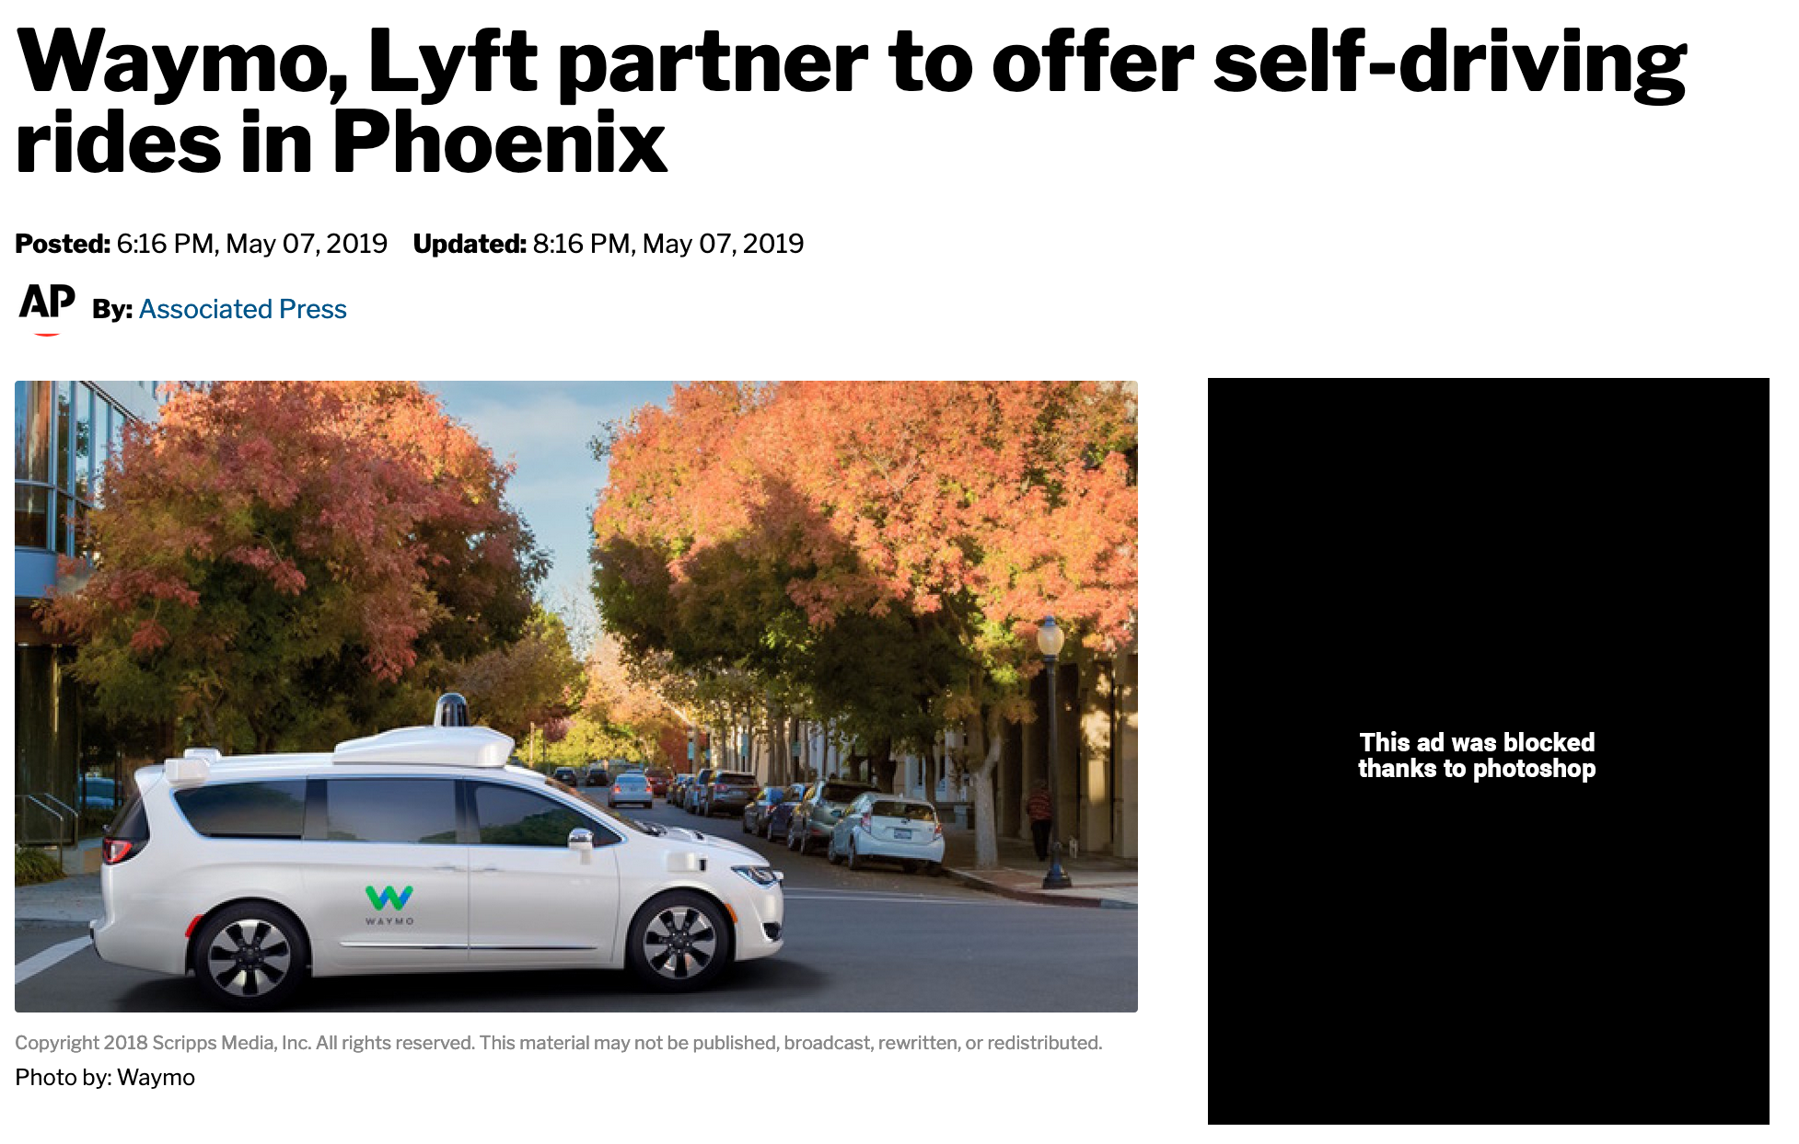
www.kb.gg/databases

Slide 16
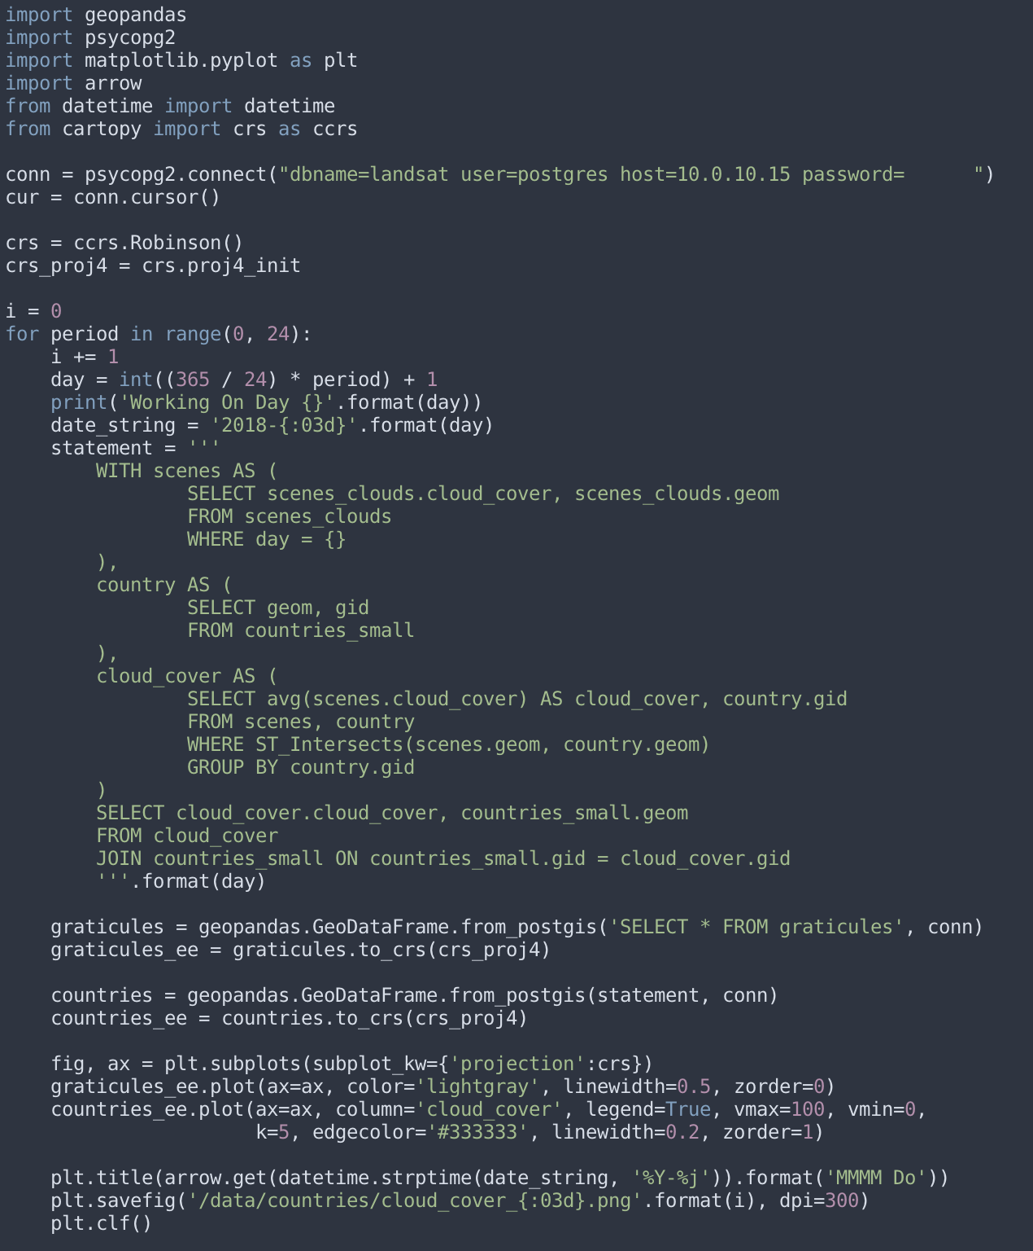
www.kb.gg/databases

Slide 17
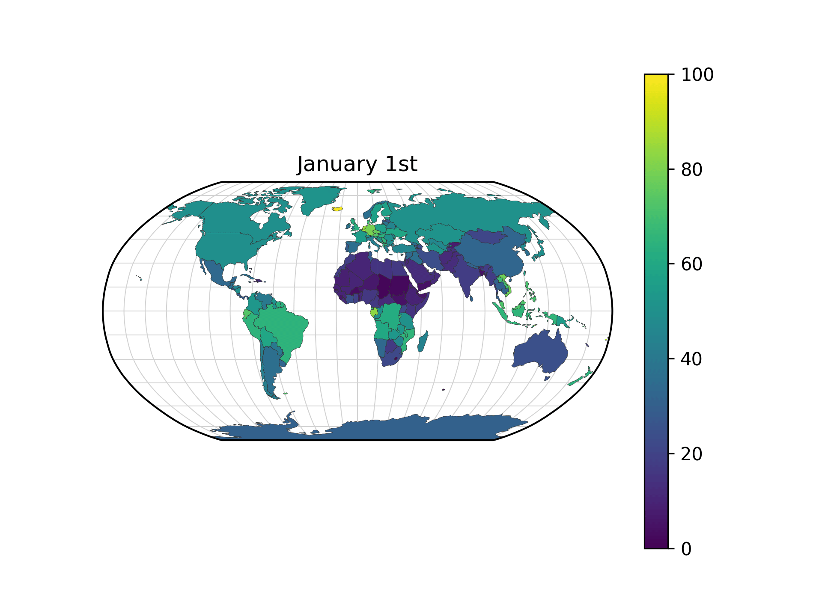
www.kb.gg/databases

